Slide 1


FIT2101 TEAM 5
Members
Scrum Master
Ooi Yi Sen
Product Owner
Jun Hoe San
Team Front-End
Joel Yang
Khant Hla Shwe
Ooi Yi Sen
Team Back-End
Chan Wai Han
Jun Hoe San
Mohammed Abidur Rashid

Slide 2
WHAT IS TO COME
Sign Up
Error handling
Login
Main Page
Widgets
Live Data
Admin page
Log Out
Definition of Done
Scope Change
Target Velocity

Slide 3

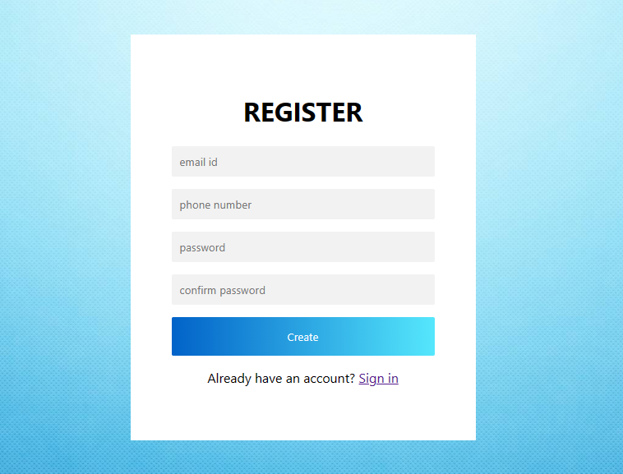
Sign Up
“As a client I would like users to signup so that I can gather their information”

Slide 4
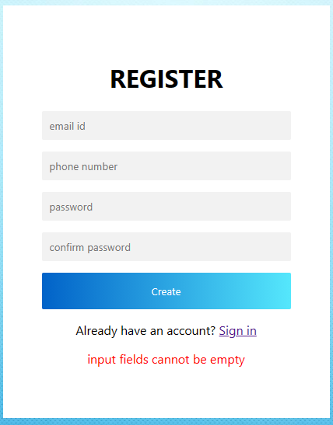
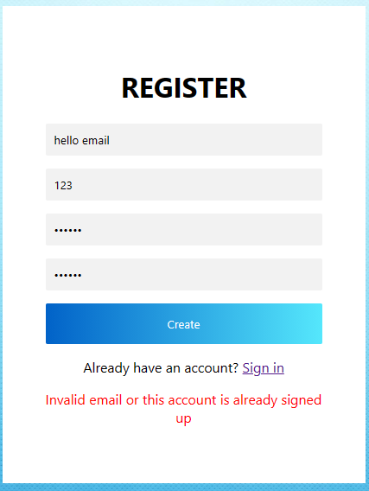
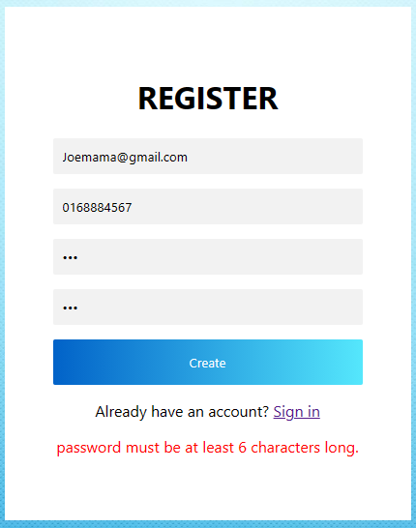
Handling Invalid User Inputs (NFR)
“As a user I would like to see alerts so that I know about the occurrence of errors”

Slide 5
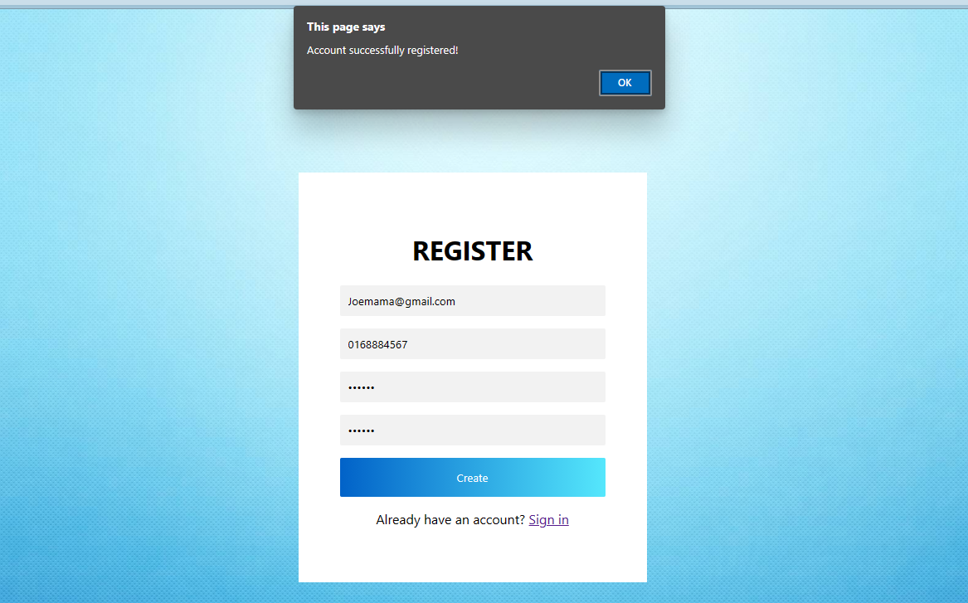

Slide 6
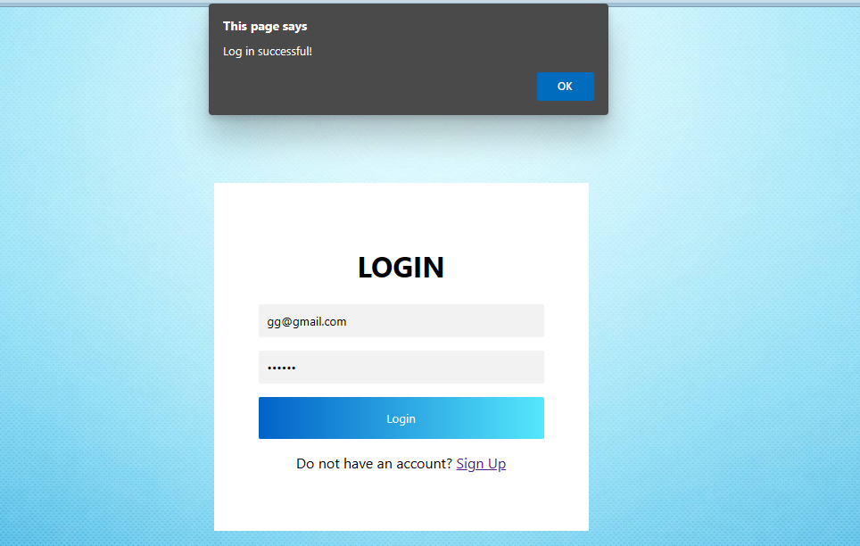
Login
‘’As a client I would like users to login to my application so that I can collect their information’’

Slide 7
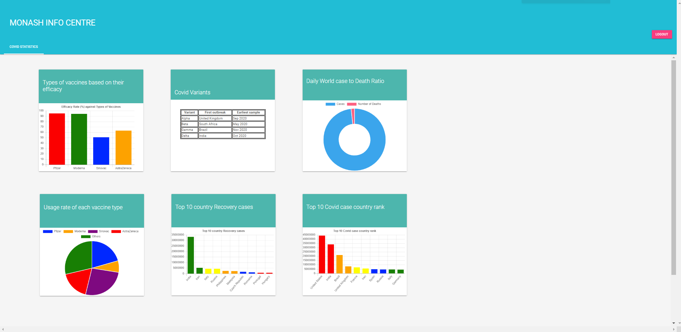
Main Page
“As a client would like the interface to have a light theme color so that it is pleasing to the eye”
“As a client like to have widgets encapsulated in a dashboard so that it enhances visibility”

Slide 8
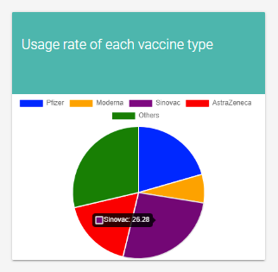
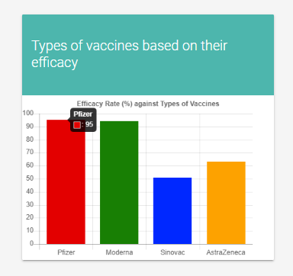
Non-live Data Widgets
“As a client I would like to see graphs and tables for my result so that I can easily identify the data changes”
“As a user I would like my data displayed to be more readable”

Slide 9
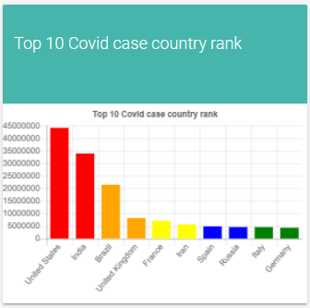
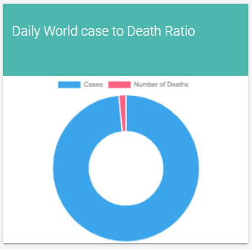
Live Data Widgets
Covid Api link:
https://www.npmjs.com/package/covid19-api
Chart js:
https://cdn.jsdelivr.net/npm/chart.js

Slide 10
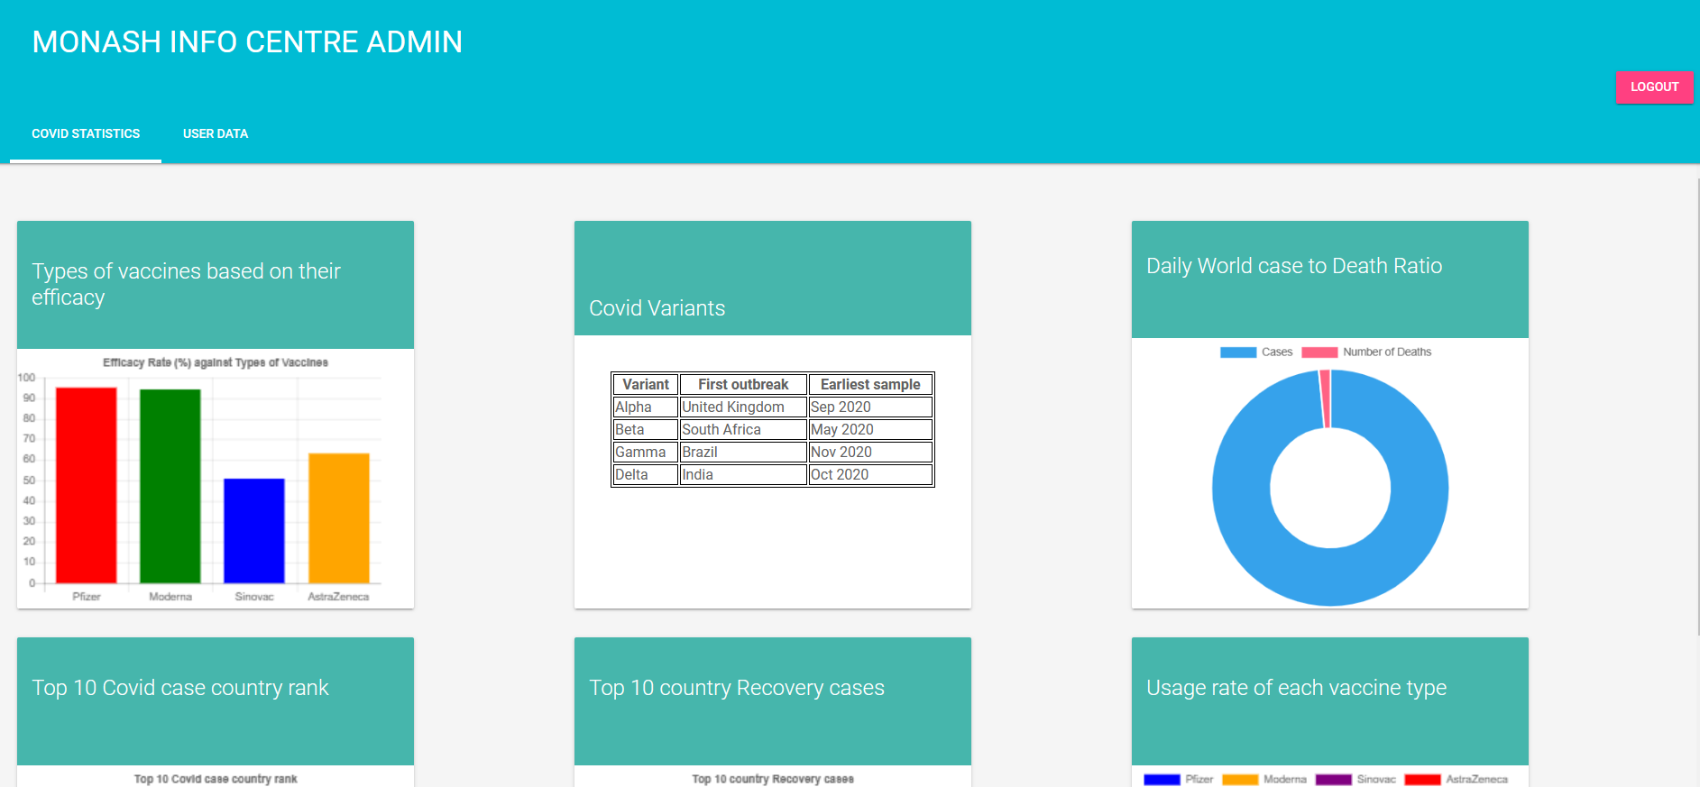
Admin Page
“As a client, I want to have an admin page to access the data of my users easily”

Slide 11
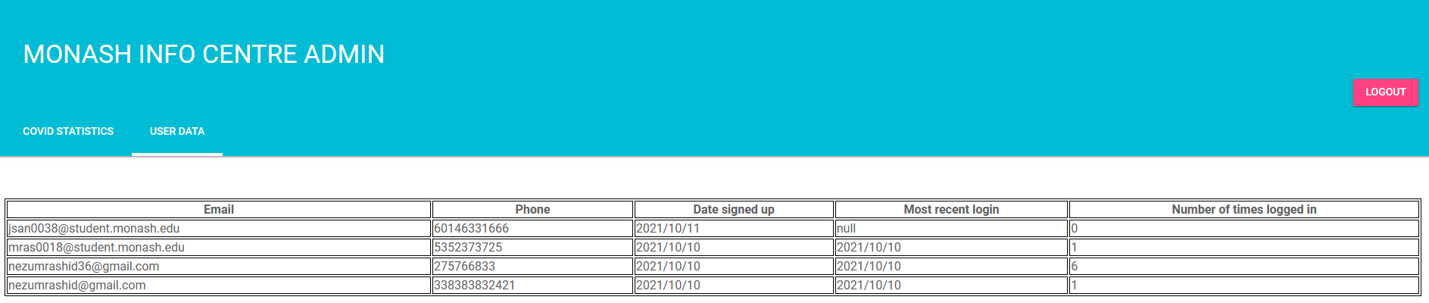
“As a client I want to be able to see the data of my users stored and presented neatly in my admin page.
The user data includes:
1. Email
2. Phone Number
3. Most recent login Date
4. Sign-up Date
5. Number of times user has logged in

Slide 12
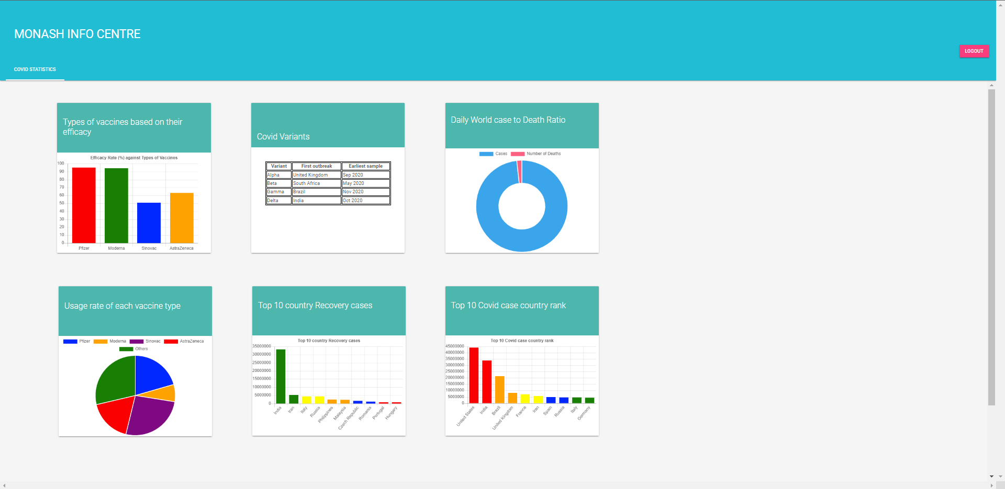
Log Out
“As a client I would like to logout so that I can login with a different account”

Slide 13

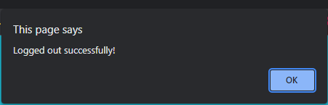
Log Out
Non-functional requirement
‘’As a user I would like to be notified that my actions that are successful’’
Notes:
Alert is a non-functional requirement

Slide 14
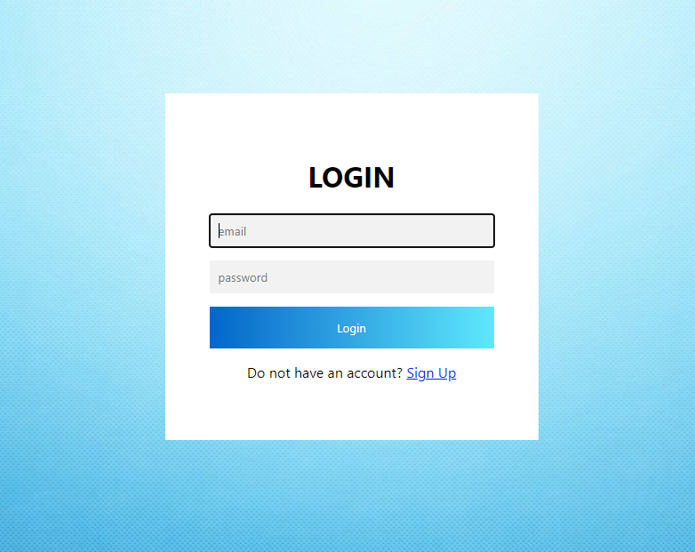
Log Out

Slide 15
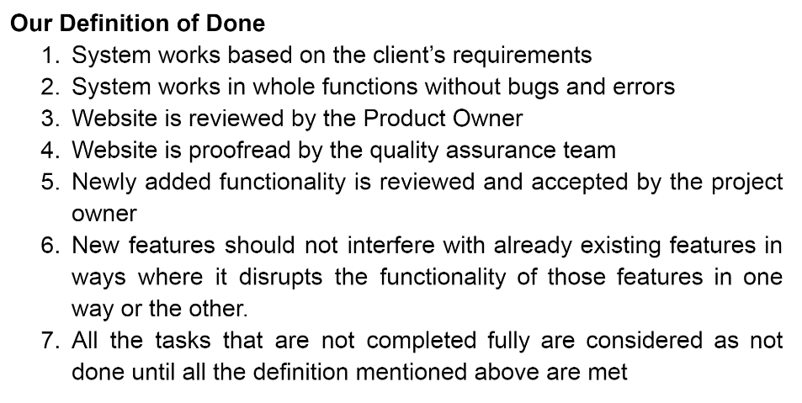
Definition of Done
System works based on client’s requirements.
System works in whole functions without bugs and errors.
Website is reviewed by the Product Owner.
Website is proofread by the quality assurance team.
Newly added functionality is reviewed and accepted by the project owner.
New features should not interfere with already existing features in ways where it disrupts the functionality of those features in one way or the other.
All the tasks that are not completed fully are considered as not done until all the definition mentioned above are met.

Slide 16

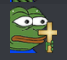

Scope Change
JavaScript, HTML, CSS

Slide 17
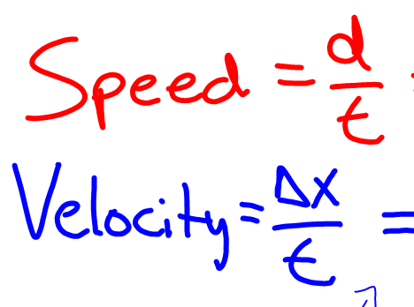
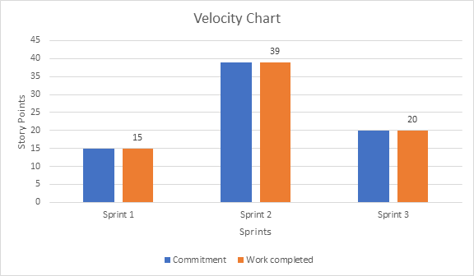
Target Velocity

Slide 18
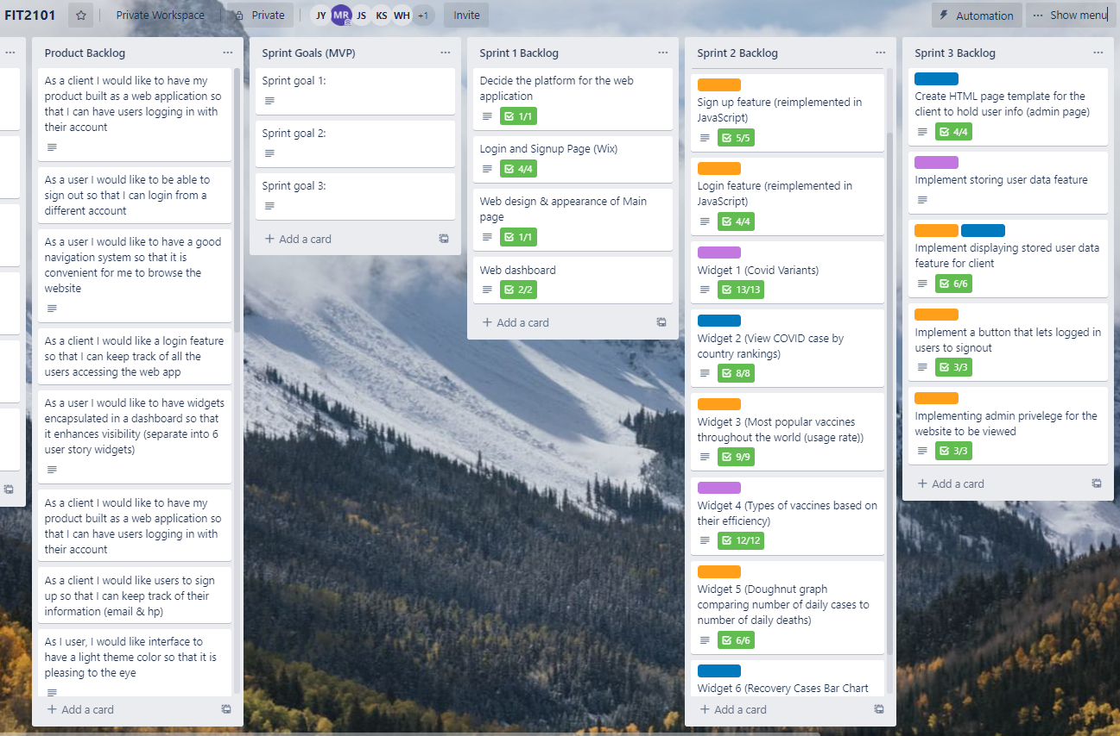

Slide 19

Thank You

